Slide 1
Project on C-programming
Debendra Mahato (THA081 BCT007) Purnika Poudel (THA081BCT025) Shraddha Regmi (THA081BCT040) Department of Electronics and Computer Engineering Institute of Engineering,Thapathali Campus March 21, 2025

Slide 2
Digital record keeping system of hospital
-Lets stores our data in a digital form.

Slide 3
Introduction
Hospital management system, for managing the data of hospital.
Developed with the aim of managing the data of an hospital in a digital way.
Built with:
Language: C
Database: SQLite
Libraries Used: SQLite3

Slide 4
Features
Add, delete and update the existing data .
User login system.
Scheduled the appointment and see the past history of patient.
Manage the stock of medicine in pharmacy.

Slide 5
Work flow
Admin
Manage, keep records, add, delete and update the existing data.
Add, delete and update the existing data of the medicines.
User(patient)
User can create the account and setup the password.
Patient can scheduled the appointment, see the past history and search for the doctors.

Slide 6
Doctor
Doctor can see the scheduled appointment and past history of patient.

Slide 7
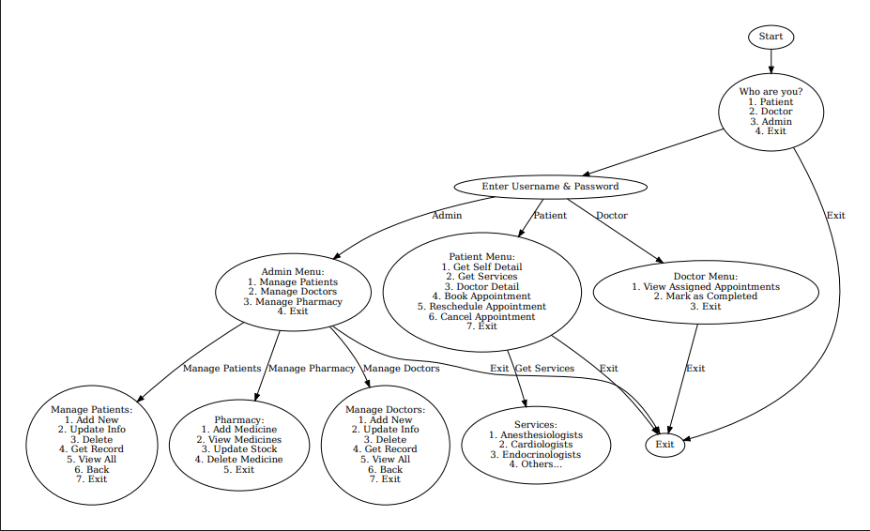
Flowchart

Slide 8
Some difficulties faced during the project
Extracting the data from database.
Managing the data.
Making function in C.

Slide 9
Improvements
More functions can be added.
UI/UX.

Slide 10
Conclusion
Digital database management system offers managing the whole data digitally, saving our time and making it more secure.

Slide 11
Thank You!!

